Slide 1
KPI Analysis of Lowell General Hospital
Tabish Shamim

Slide 2
Problem Statement and Objective
Lowell General Hospital remains dedicated to ensuring patient well-being. To support this commitment, we actively track critical metrics that influence patient safety and satisfaction. Conducting a systematic analysis of these indicators is vital for spotting trends, evaluating performance, and creating data-driven strategies to improve the overall patient experience.
Objective:
Evaluate how key performance indicators (KPIs) influence the patient experience.
Explore the relationships and correlations among different KPIs.
Compare performance against benchmarks and suggest actionable improvements.

Slide 3
Dataset Overview
Source : Lowell General Hospital Dataset
Size: (60,4)
Timeframe: 01/01/2020 to 01/12/2024 (5 years)
Key Variables:
Month
Average Licensed Bed Occupancy Rate
Unassisted Fall Rate per 1,000 Patient Days
Staff Responsiveness Domain Top Box Score

Slide 4

Understanding KPIs
Average Licensed Bed Occupancy Rate
This measure is captured internally and is measured as a percentage. It is calculated as:

Slide 5
Understanding KPIs
Staff Responsiveness Top Box Score
The HCAHPS Survey, sent to patients post-discharge, assesses Staff Responsiveness through two key questions:
Q1. How often did you receive help promptly after pressing the call button?
Q2. How often did you get timely assistance with bathroom needs or using a bedpan?
It is calculated as:

Slide 6

Understanding KPIs
Unassisted Patient Falls per 1000 Patient Days
This measure is captured by the National Database of Nursing Quality Indicators (NDNQI). A patient fall is defined as an unplanned descent to the floor with or without injury. Unassisted falls are where there is no staff member present to assist the patient. This is measured as:

Slide 7
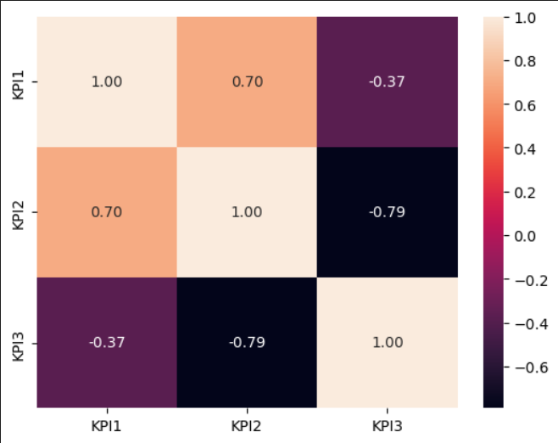
Relationship between the KPIs
Heatmap of Correlations between the KPIs
Bed Occupancy Rate & Fall Rate per 1,000 Patient Days – 0.70 (Strong positive correlation)
Bed Occupancy Rate & Staff Responsiveness Score – -0.37 (Moderate negative correlation)
Fall Rate per 1,000 Patient Days & Staff Responsiveness Score – -0.79 (Strong negative correlation)

Slide 8
Relationship between the KPIs
Bed Occupancy Rate & Fall rate per 1000 Patient Days
The correlation between bed occupancy rate and fall rate per 1000 days is 0.70 which indicates a strong positive correlation. It means that with increase in bed occupancy the fall rate would increase as well. To mitigate this, there is a need for more efficient staffing or patient monitoring in case the occupancy increases.

Slide 9
Relationship between the KPIs
Bed Occupancy Rate & Staff Responsiveness Score
The correlation between bed occupancy rate and staff
responsiveness is -0.37 indicating a moderate negative
correlation. It means that staff responsiveness tend to
decrease with higher bed occupancy rate. The hospital need a
better resource management.

Slide 10
Relationship between the KPIs
Fall Rate per 1000 Patient Days & Staff Responsiveness Score
The correlation between fall rate per 1000 days and staff
responsiveness is -0.79 indicating a strong negative correlation. It
means that the higher the staff responsiveness the lower the fall
rate.

Slide 11
Relationship between the KPIs
Summary of Relationships between the KPIs
When the hospital operate at higher occupancy level, the fall rate
tend to rise while staff responsiveness declines slightly. Improved
staff responsiveness decreases patient falls which would contribute
to improved patient safety through reduced patient fall incidents.

Slide 12

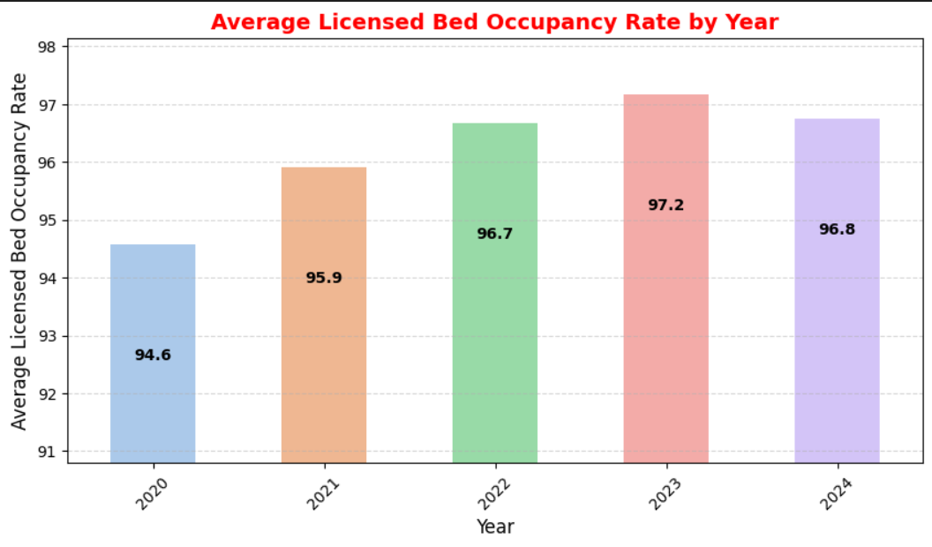



Trends In Data Over Time
Average Licensed Bed Occupancy Rate
Unassisted Fall rate per 1000 Patient days
Staff Responsiveness Domain Box Score

Slide 13
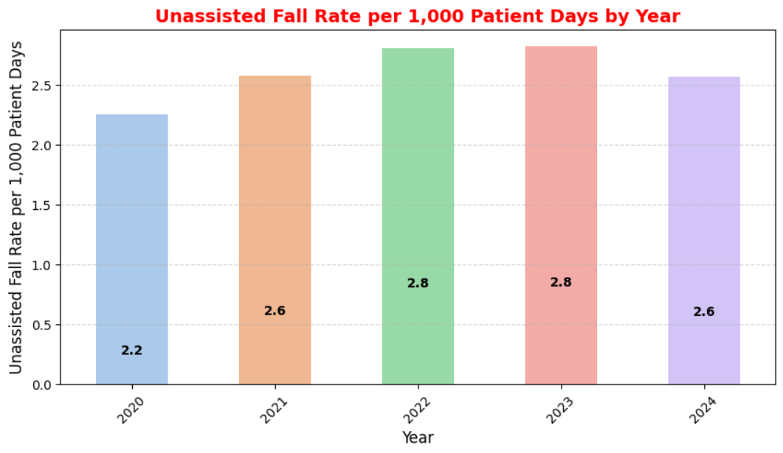
Trends In Data Over Time
Average Licensed Bed Occupancy Rate
Unassisted Fall rate per 1000 Patient days
Staff Responsiveness Domain Box Score

Slide 14
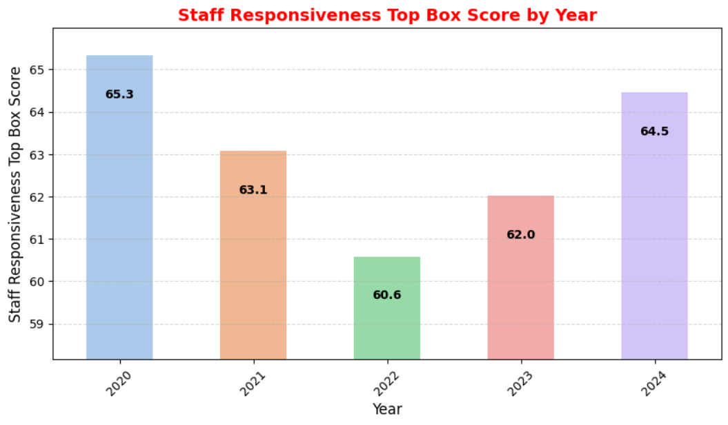
Trends In Data Over Time
Average Licensed Bed Occupancy Rate
Unassisted Fall rate per 1000 Patient days
Staff Responsiveness Domain Box Score

Slide 15
Benchmark Comparison
L.G Hospital: 96.22%
U.S. Benchmark: ~66%
Findings: The hospital's occupancy runs above than the national average showing both storing community need and effective bed management. However, a sustained high occupancy can adversely affect the care environment via increased pressure on staff and reduced patient satisfaction.
Average Licensed Bed Occupancy Rate
Unassisted Fall rate per 1000 Patient days
Staff Responsiveness Domain Box Score

Slide 16
Benchmark Comparison
L.G Hospital: 2.61 Falls per 1,000 patient days
U.S. Benchmark: 2.3 - 13 Falls per 1,000 patient days
Findings: The fall rate of the hospital is on the
lower side of the national average range. It shows
effective safety protocols and prevention
initiatives. It is critical to maintain continuous
surveillance to mitigate such incidence in case of
increased bed occupancy.
Average Licensed Bed Occupancy Rate
Unassisted Fall rate per 1000 Patient days
Staff Responsiveness Domain Box Score

Slide 17
Benchmark Comparison
L.G Hospital: 63.09%
U.S. Benchmark: 85% - 90%
Findings: The response rate of that the staff is significantly lower than the industry standards which shows potential delay in patient care delivery. The elevated bed occupancy rate puts constraints on the hospital staff. Improving staff levels, sharing patient update faster, and communicating when extra help is needed can improve the metric and patient experiences.
Average Licensed Bed Occupancy Rate
Unassisted Fall rate per 1000 Patient days
Staff Responsiveness Domain Box Score

Slide 18
Benchmark Comparison
Final Assessment:
Increased bed occupancy and decreased staff responsiveness shows strain on the hospital staff.
Unassisted fall rate is lower even though the bed occupancy is high.
To enhance patient satisfaction and overall hospital efficiency, improved staff responsiveness is needed.
Average Licensed Bed Occupancy Rate
Unassisted Fall rate per 1000 Patient days
Staff Responsiveness Domain Box Score

Slide 19
Thanks! Contact Tabish Shamim +91 7800090800 Tabishshamim9@gmail.com

